Slide 1

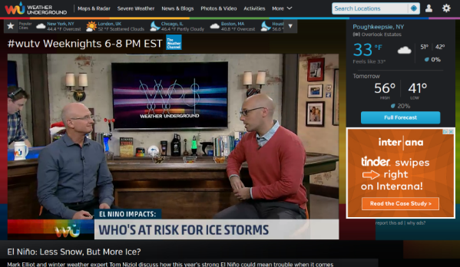
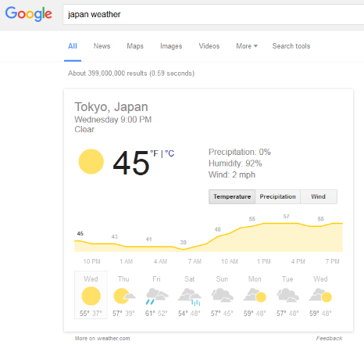
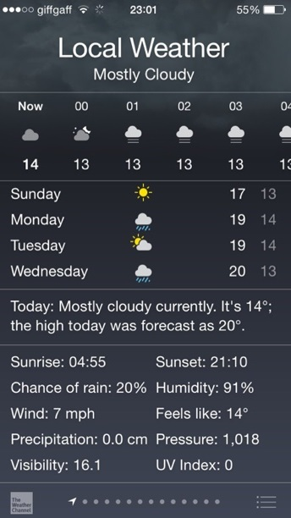
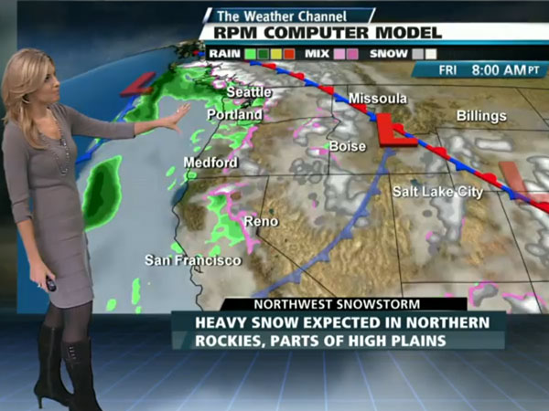
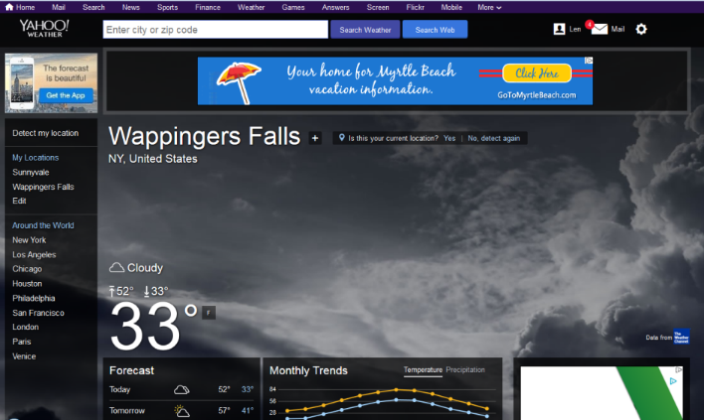
The Weather Company is the #1 provider of weather data in the world
TV Weather
Digital Consumer Weather
B2B Weather
Apple iOS
The Weather Channel
Google
Yahoo
Weather Underground

Slide 2





Mapping The Atmosphere: a Big Data and IoT Approach To Precise Weather
Up to
2.2 Billion
weather forecast locations
15 Million
pressure readings from mobile devices
Atmospheric data from 50,000 flights per day
> 190,000 worldwide weather stations
> 150 forecast models
serve as inputs to forecast

Slide 3
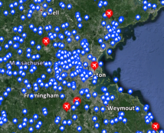
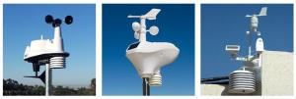
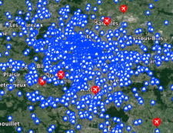
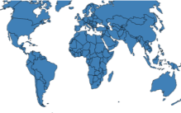
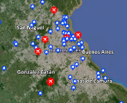
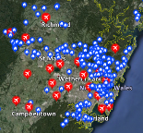
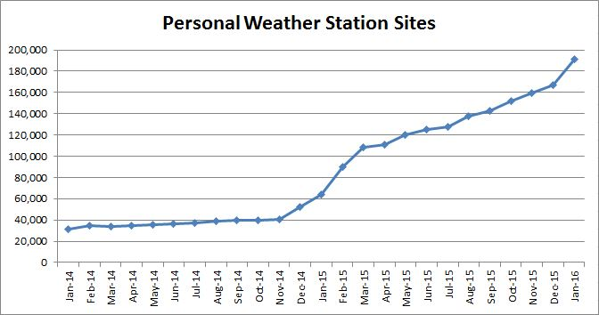
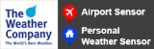
Through the Personal Weather Station Network of >190 000 sensors, The Weather Company offers industry-leading weather data coverage
Boston, USA
Personal weather sensors
Sydney, Australia
Buenos Aires, Argentina
Sydney, Australia

Slide 4
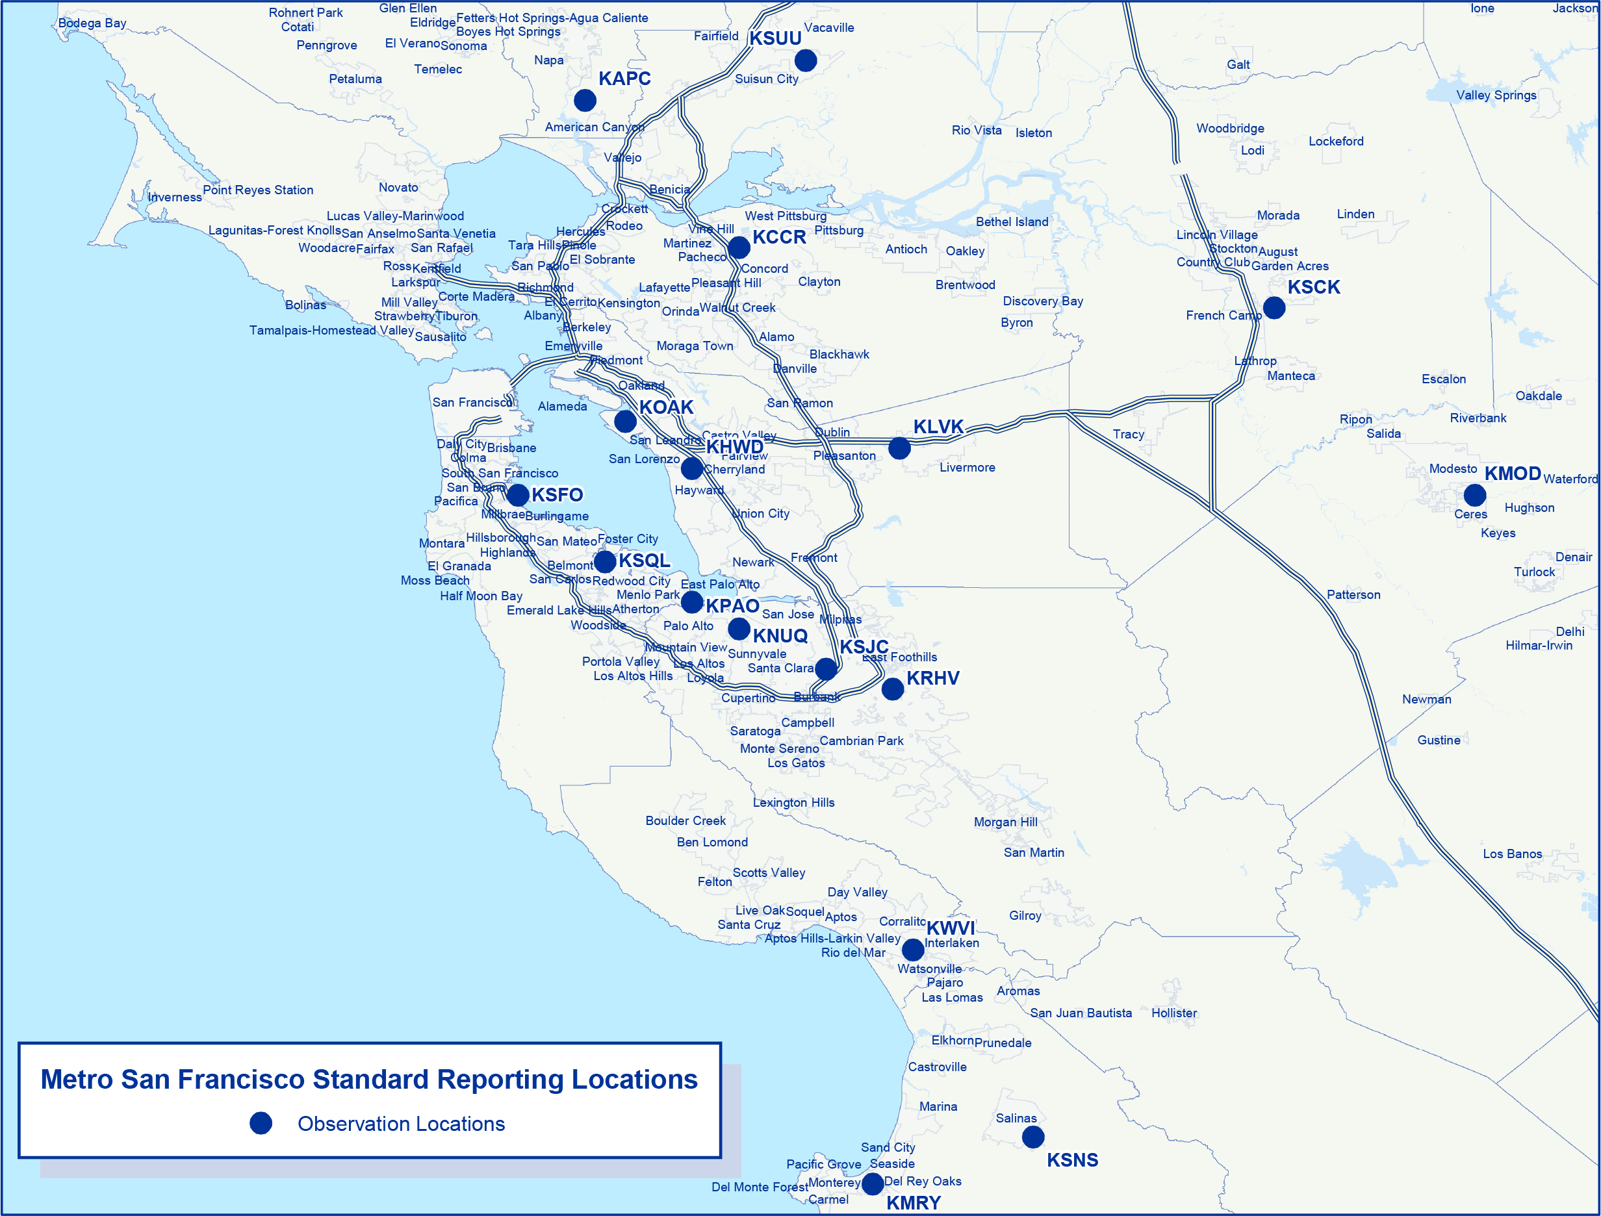
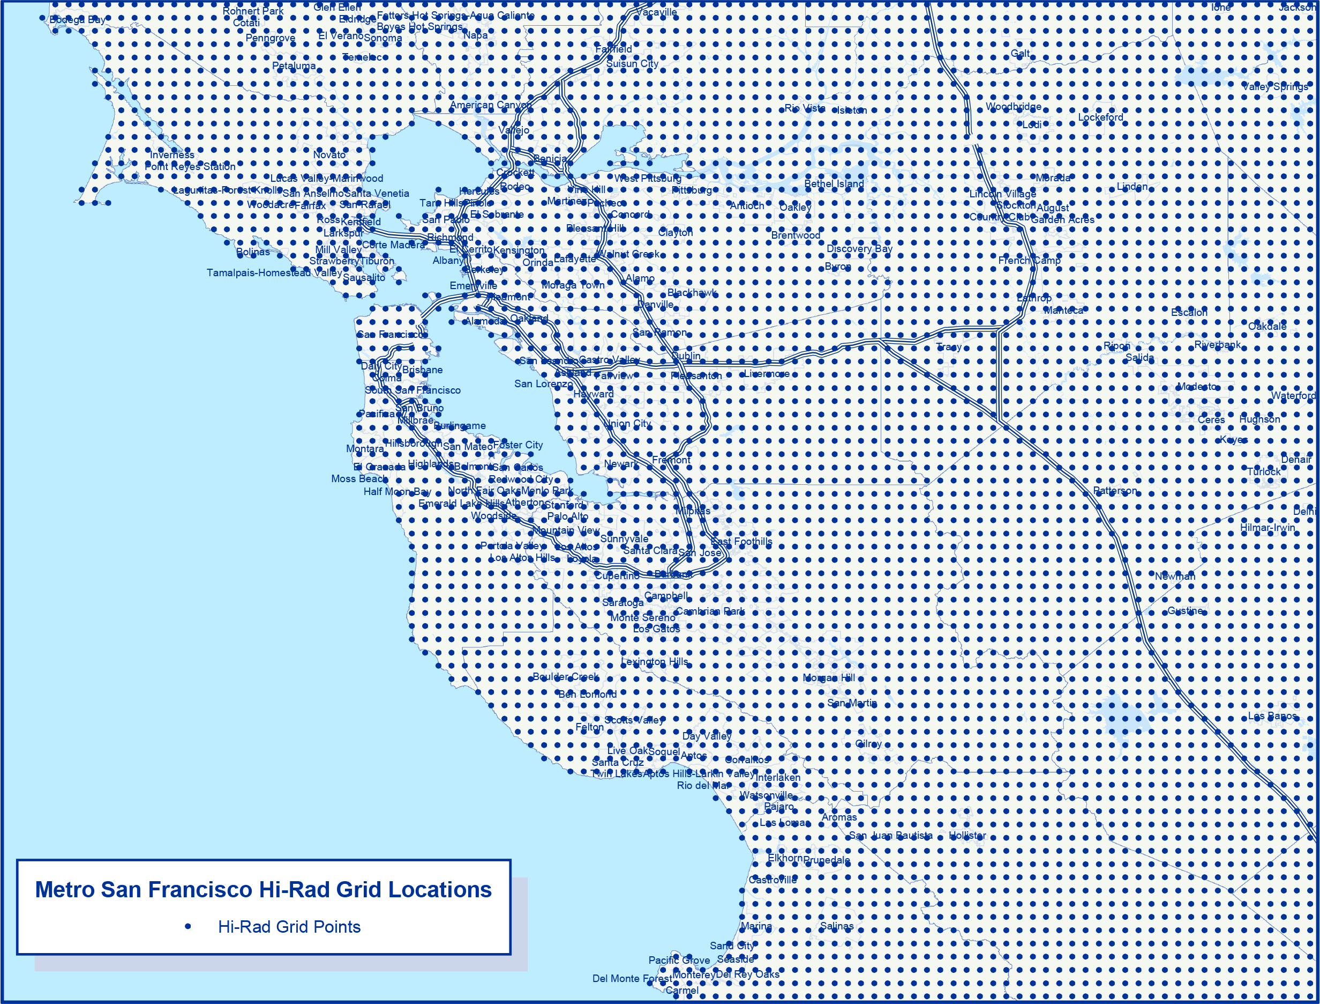

Through a unique combination of >150 forecast models, The Weather Company can deliver hyperlocal, precise and on-demand forecasts
Standard Observations
In The Past, Relatively Few Observation Locations
The Weather Company Forecast Grid
Forecasts: On Demand, Up To 2.2 Billion Precise Locations, Updated Every 15 Minutes

Slide 5
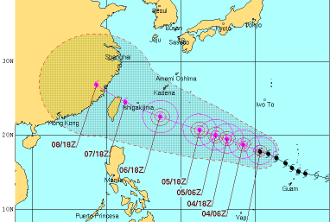
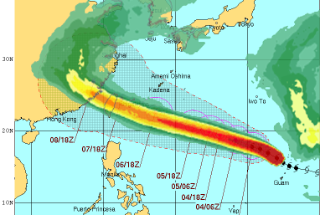
Probabilistic Forecasts
Forecast for Super Typhoon Soudelor issued August 3, 2015
Joint Typhoon Warning Center (JTWC)
Traditional government cone of uncertainty uses standardized risk analysis for scenario
Limits risk planning
TWC Tropical Prediction
Cone better defined
Uses multi-member ensembles with distribution learning algorithms
Notes:
5

Slide 6
Weather Data Packages
Historical
Current
Future
Historical Weather
Historic weather observations from stations and crowd-sourced sensors including proprietary radar-derived severe weather data sets (i.e. hail, temperature, wind, humidity, pressure, dew point, visibility, and UV Index).
Current Conditions
Current weather observations from stations and crowd-sourced sensors, including proprietary, interpolated 500 meter grids.
Seasonal Forecast
Comprehensive long-range forecast beyond traditional 15-day forecast. Temperature and precipitation anomaly predictions extend 4 months into the future.
Severe Weather Disaster
Hail, tornado, wind, snow, rain, ice, and lightning reports in real-time and previous 24-hour observations.
Tropical Weather Forecast
Probabilistic, global hurricane forecasts up to 15 days in the future; water levels, surges, and wave height levels up to 48 hours in the future.
Location Data
TWC Proprietary Data tracking movement patterns for tens of millions of Mobile App Users for use in Analytics.
Caveat: usability for Europe under investigation
Lifestyle
Air quality, pollen, and flu data.
Enhanced Forecast
Global forecast visualization and polygon data for integration into any GIS platforms, including 15-day hourly forecasts.
Weather Imagery
Radar, Doppler, and global satellite imagery updated 5-60 minutes.
All data packages accessible via programmatic API for integration into applications
Alerts & Notification Package
Severe weather, wildfire, and earthquake alerts notification in real-time and immediate future (1-5 days).

